Slide 1
Database Merger
Database Design Team
Samuel Germain
Warren Fehr
Richard Granger
Mohammed Kassem
Vigor

Slide 2
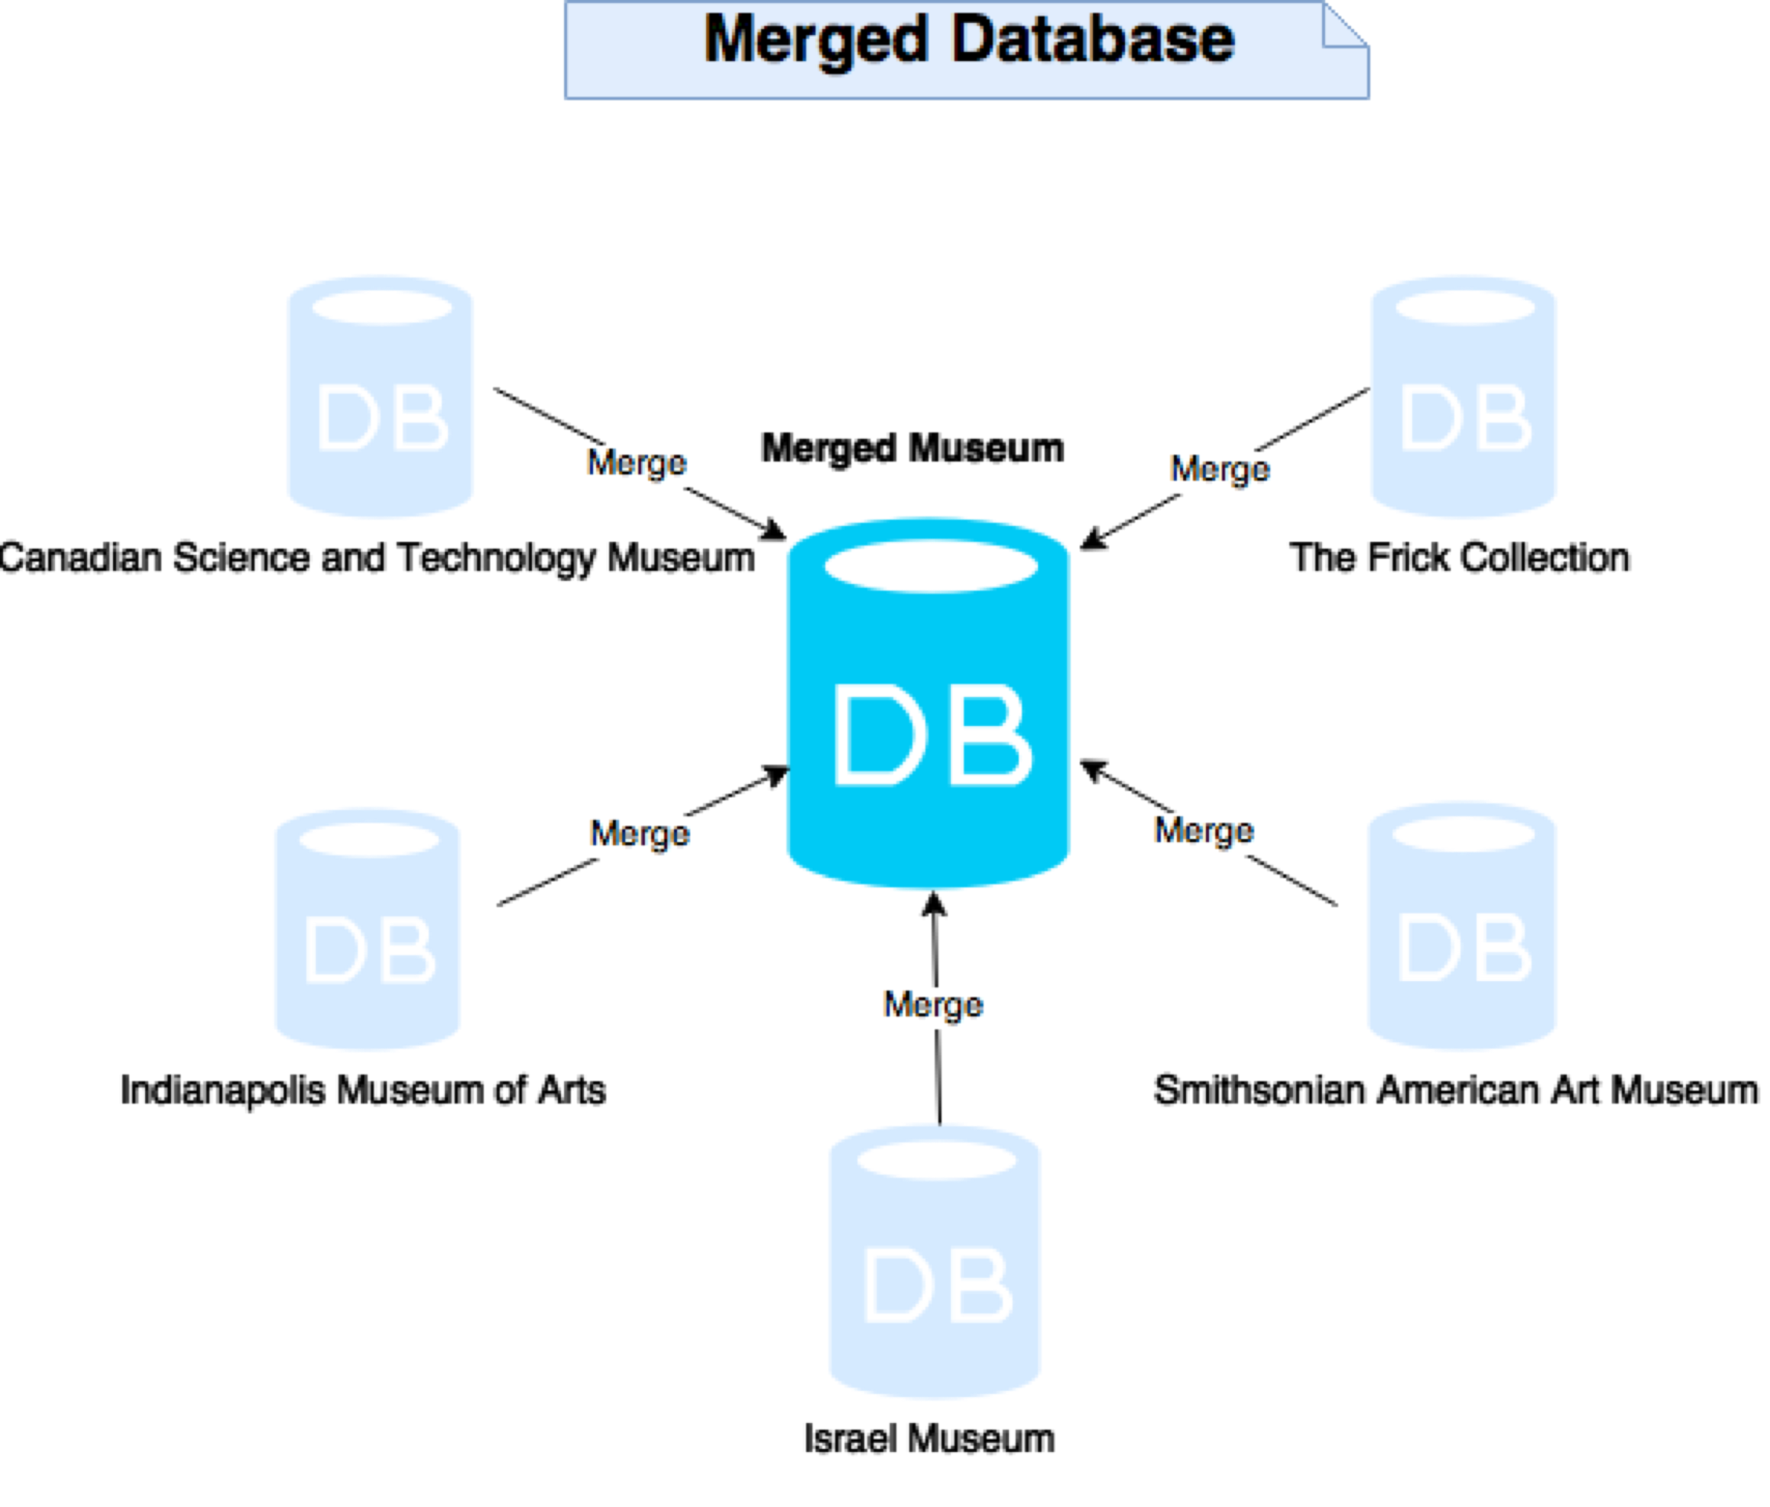

Slide 3
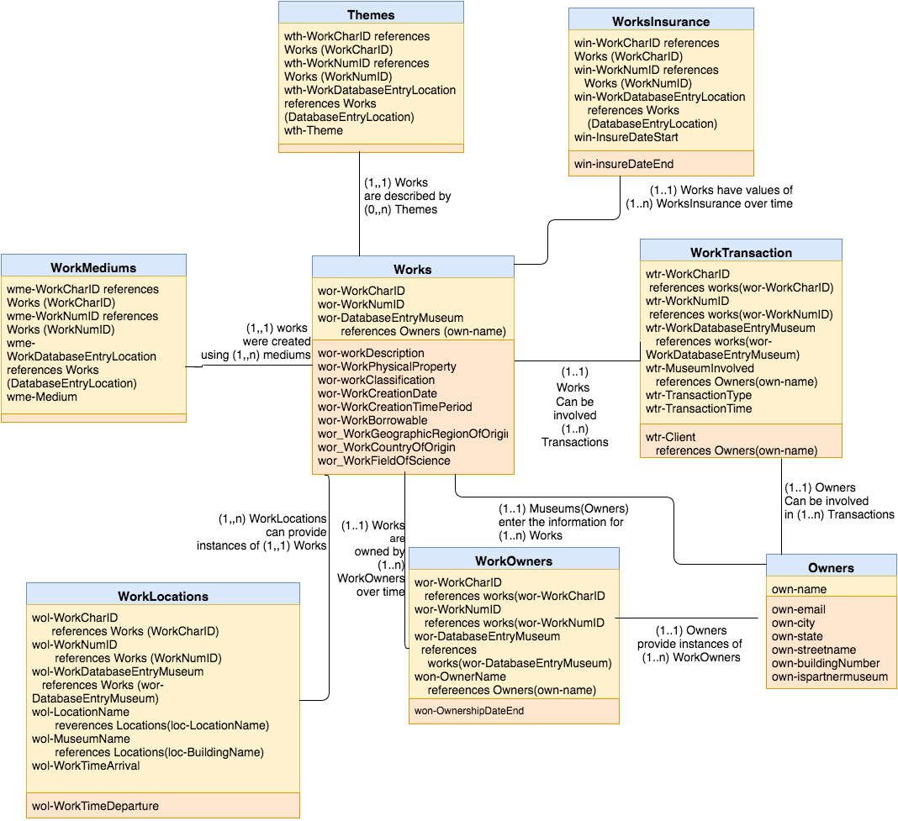
Works

Slide 4
Work Categorization
Method 1
Types
Painting
History Painting
Portrait Art.
Landscape Painting
Clocks
Mantel
Pendant
Textile Art
Tapestry
Carpet
Method 2
Types
Computing Technology
Digital Peripheral Devices
Analog Computing Devices
Astronomy
Observation Equipment
Research Commemorative
Photography
Cine Cinemas
Computing Devices
Method 3
Types
Metal Work
Painting
Furniture
Clothing
Subtypes
Asian Art
American Modernism
Decorative Arts
Native Arts of the Americas
Extra Descriptive Categories
Human Creation
The Natural World
Artistic Intricacy
The Human Body
War Pieces

Slide 5
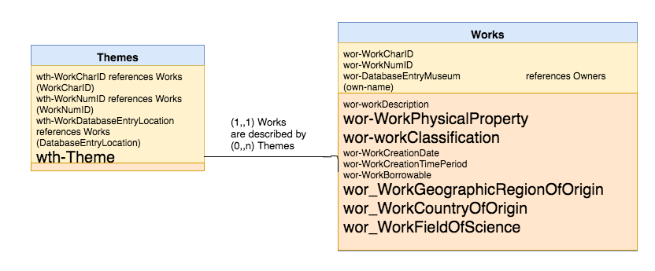
Work Categorization

Slide 6
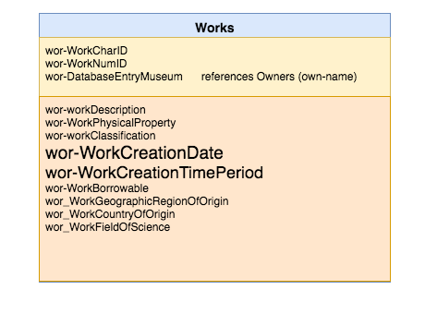
Work Creation Dates

Slide 7
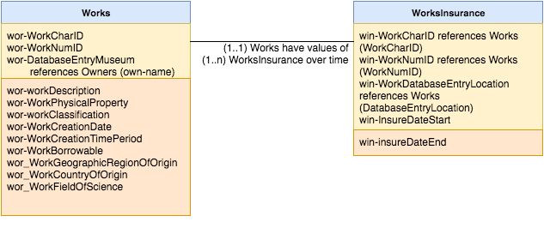
Work Insurance Values

Slide 8
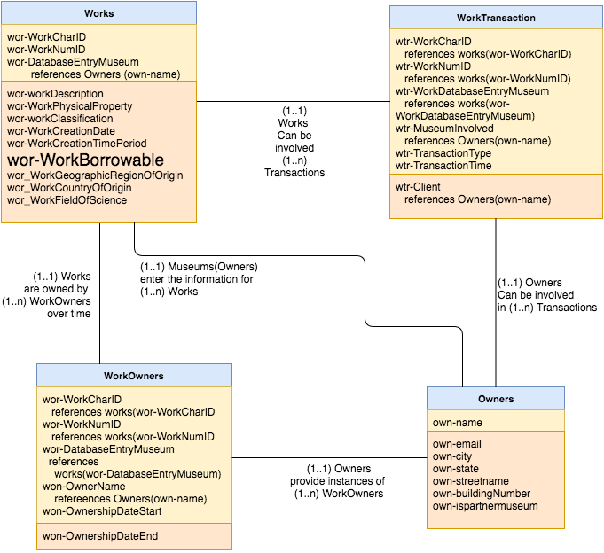
Transactions

Slide 9
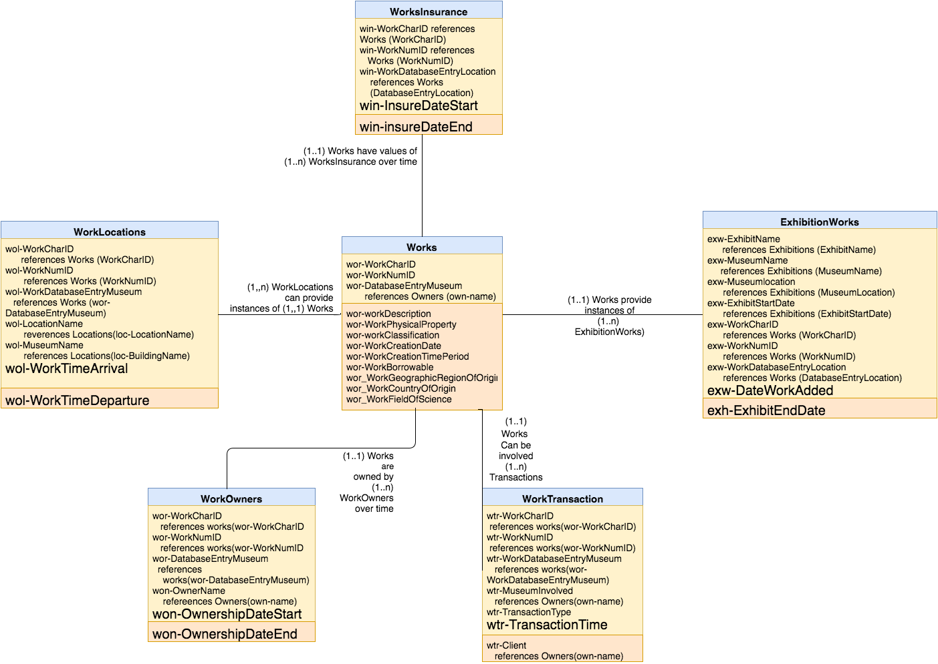
Management of
Temporal Data
Pertaining to Works

Slide 10
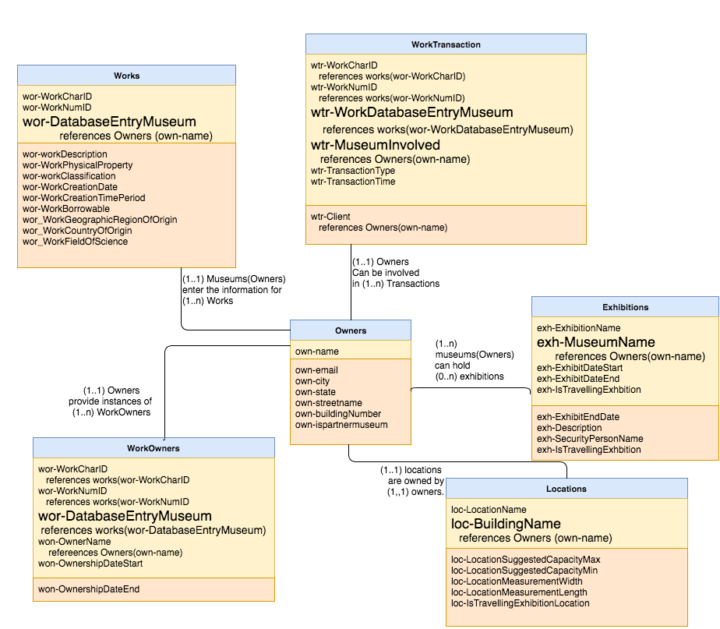
Keeping
Information
Unique

Slide 11
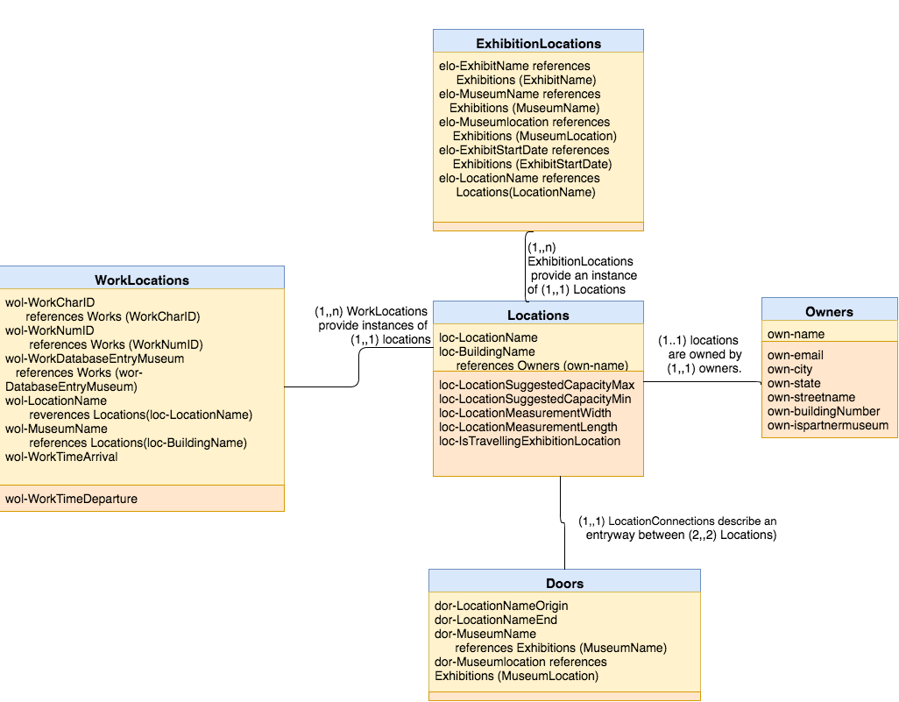
Locations

Slide 12
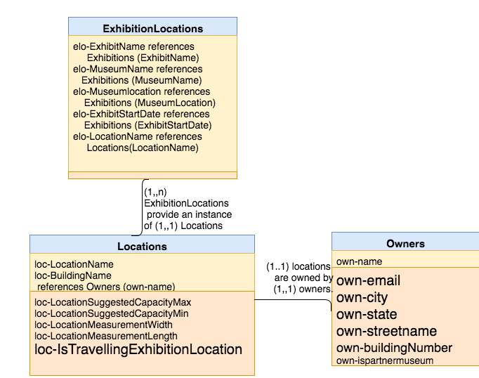
Management
Of Locations
For Travelling
Exhibitions

Slide 13
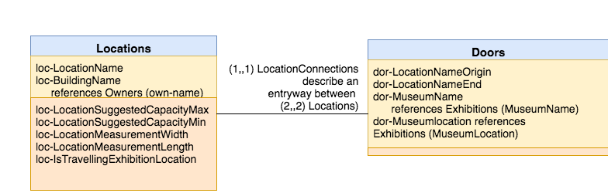
Doors

Slide 14
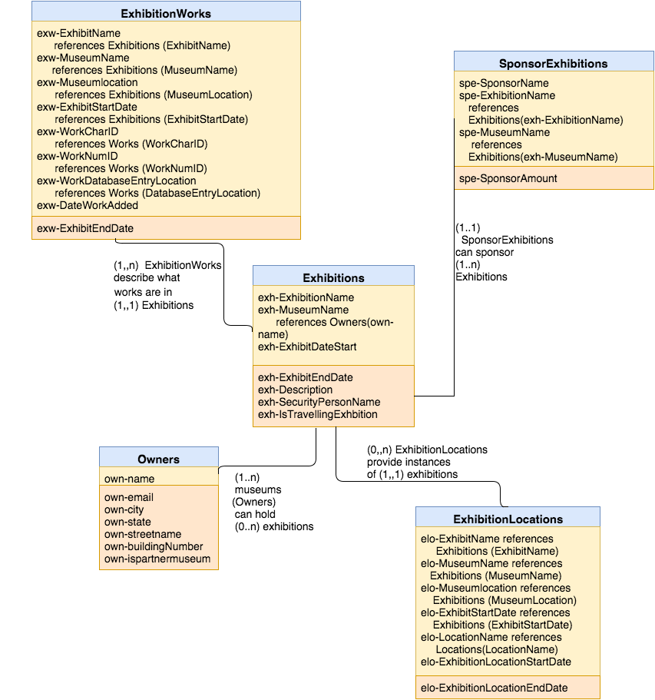
Exhibitions

Slide 15
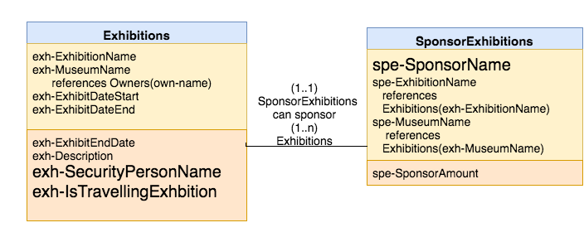
Management of
Travelling Exhibitions

Slide 16
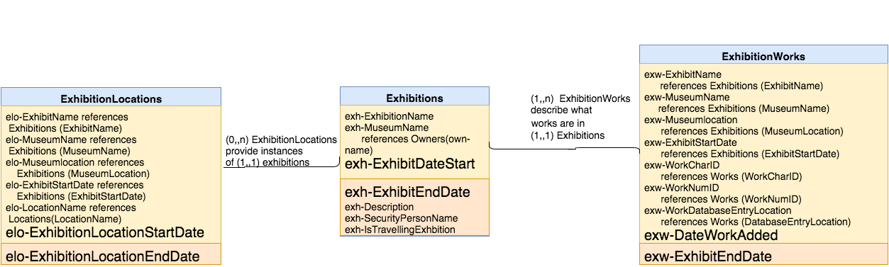
Management of Temporal
Data Pertaining to Exhibitions

Slide 17
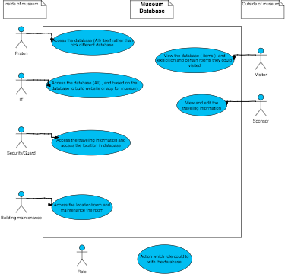
Views

Slide 18
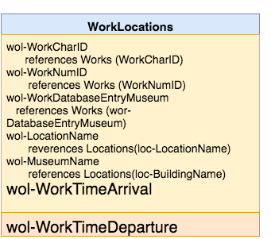
Triggers

